Slide 1

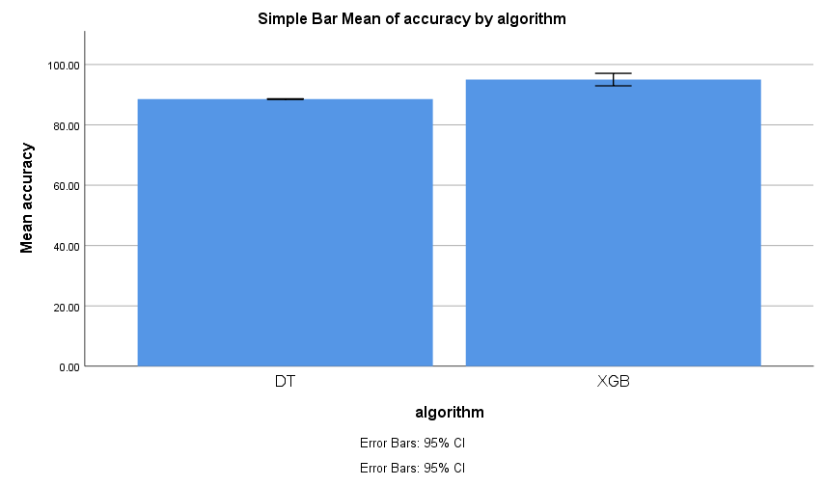
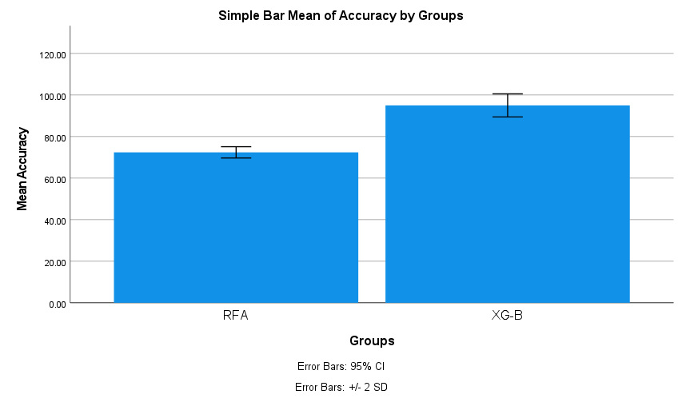
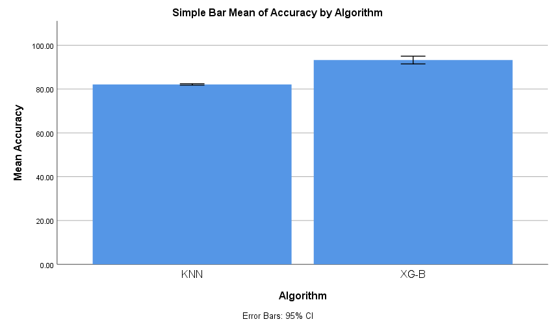
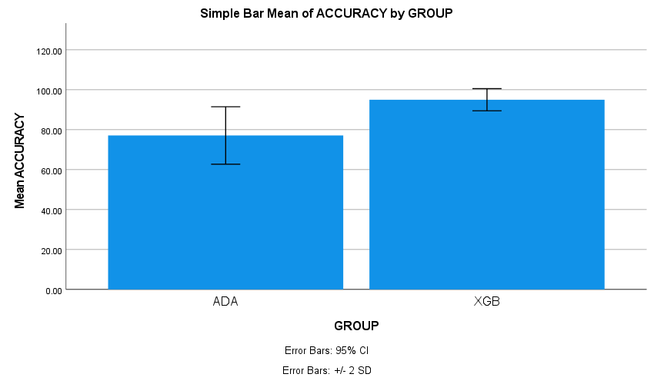
Register No: 192210400
Students Name: M Mohan Reddy
Guided By Dr. G Charlyn Pushpa Latha
Improved Accuracy of Ethereum Transaction Fraud Detection
Using Extreme Gradient Boosting Machine Compared with
Decision Tree Classifier
Improved Accuracy of Ethereum Transaction Fraud Detection
Using Extreme Gradient Boosting Machine Compared with
Random Forest Classifier
INTRODUCTION
INTRODUCTION
Ethereum transaction fraud poses significant risks due to the irreversible nature of blockchain transactions. Fraud detection systems must balance accuracy and efficiency to mitigate financial losses.
Machine learning models, such as Decision Trees (DT) are traditionally used for classification tasks but may struggle with imbalanced datasets, which are common in fraud detection.
This study compares XG-Boost and Decision Tree classifiers to evaluate their effectiveness in detecting fraudulent Ethereum transactions.
The research highlights XG-Boost’s superior performance in identifying rare fraud cases, leveraging gradient boosting to improve prediction accuracy.
Ethereum transaction fraud poses significant risks due to the irreversible nature of blockchain transactions. Fraud detection systems must balance accuracy and efficiency to mitigate financial losses.
Blockchain technology, particularly Ethereum, has emerged as a decentralized framework for secure transactions. However, fraudulent activities within this system continue to pose critical challenges.
This research focuses on detecting Ethereum-based fraudulent transactions using machine learning techniques, emphasizing improved detection accuracy.
Two classification models are explored: Random Forest Classifier RF and Extreme Gradient Boosting (XG-Boost), both evaluated for their effectiveness in identifying fraudulent patterns.
MATERIALS AND METHODS
MATERIALS AND METHODS
Train/Test
XG-Boost
Evaluate XGB
Compare Accuracy
Output
Train/Test
XG-Boost
Evaluate XGB
Data Collection
Pre-processing
Evaluate DT
Data Collection
Pre-processing
Compare Accuracy
Output
Train/Test
Decision Tree
Train/Test
Random Forest
Evaluate RF
RESULTS
The study shows that XG-Boost algorithm has higher accuracy (94%) than Decision Tree (88.5%)in Ethereum Transaction Fraud Detection .
The study focused on comparing the performance of the XG-Boost (XGB) algorithm with the Decision Tree (DT) algorithm for fraud detection in ethereum transactions.
The 94% confidence interval of the mean difference (6.82 to 11.46) from the t-test further supports the consistency and reliability of the XG-Boost algorithm in fraud detection tasks.
In contrast, the Decision Tree model is faster and simpler, but less accurate.
RESULTS
The study shows that the XG-Boost algorithm achieved a higher accuracy (94%) than the Random Forest Classifier (72.4%) in Ethereum transaction fraud detection.
The study focused on comparing the performance of the Extreme Gradient Boosting (XGB) algorithm with the Random Forest (RF) algorithm for identifying fraudulent activity in blockchain-based transactions.
The 94% confidence interval of the mean difference (4.78 to 8.91) obtained from the independent samples T-test supports the consistency, and reliability of the XG-Boost algorithm in fraud detection tasks (p < 0.05).
Fig 1: Final graph
Fig 2: Final graph
DISCUSSION AND CONCLUSION
DISCUSSION AND CONCLUSION
The XG-Boost algorithm achieved an accuracy of 94%, which is significantly better than the Decision Tree algorithm 88.5% in detecting fraudulent transactions in the Ethereum blockchain network.
The t-test result (t = 5.892, p < 0.001) confirms that the difference in performance between XG-Boost and Decision Tree is statistically significant and not due to random chance.
Although XG-Boost increases computational complexity compared to the Decision Tree, the significant improvement in detection accuracy and model reliability justifies its use in high-stakes financial fraud detection scenarios.
The XG-Boost algorithm achieved an accuracy of 94%, which is significantly better than the Random Forest Classifier algorithm 72.4% in detecting fraudulent transactions in the Ethereum blockchain network.
The t-test result (t = 5.892, p < 0.001) confirms that the difference in performance between XG-Boost and Random Forest Classifier algorithm is statistically significant and not due to random chance.
While the Random Forest classifier is known for its robustness and ensemble decision-making, it demonstrated lower accuracy and greater performance fluctuation across different test scenarios
BIBLIOGRAPHY
BIBLIOGRAPHY
Lee, J., & Kim, S. (2023). Enhancing Blockchain Security: Machine Learning Approaches for Ethereum Fraud Detection. Journal of Cybersecurity and Privacy, 12(3), 45–67
Patel, R., & Zhang, Y. (2023). Comparative Analysis of Ensemble Learning Techniques in Handling Imbalanced Financial Datasets. IEEE Access, 11, 112233–112245.
Gupta, A., & Wang, L. (2024). Advanced Oversampling Techniques for Fraud Detection: A 2023 Survey. Data Mining and Knowledge Discovery, 37(4), 789–815.
Chen, T., & Li, M. (2023). Optimizing XG-Boost for Real-Time Blockchain Transaction Analysis. Proceedings of the 2023 International Conference on Blockchain Technology, 88–102.
Liu, X., Zhang, Y., & Li, J. (2024). Blockchain Fraud Detection Using Ensemble Learning Methods on Transaction Graphs. IEEE Transactions on Computational Social Systems, 10(1), 134–145.
Rahman, M., Uddin, M. S., & Khan, M. S. (2025). Machine Learning-Based Detection of Anomalous Ethereum Transactions. Journal of Financial Data Science, 5(2), 45–60.
Zhang, K., Wang, P., & Zhou, T. (2023). Comparative Study of XG-Boost and Decision Tree for Crypto Fraud Detection. ACM Transactions on Intelligent Systems and Technology, 14(4), 1–18.
Alzahrani, A., & Basheri, M. (2023). A Hybrid Machine Learning Model for Real-Time Ethereum Fraud Detection. Future Internet, 15(1), 23.
Improved Accuracy of Ethereum Transaction Fraud Detection
Using Extreme Gradient Boosting Machine Compared with
AdaBoost Classifier
Improved Accuracy of Ethereum Transaction Fraud Detection
Using Extreme Gradient Boosting Machine Compared with K
Nearest Neighbor
INTRODUCTION
INTRODUCTION
As Ethereum grows in popularity for decentralized applications and smart contracts, fraudulent transactions have also become more sophisticated and harder to detect.
This study compares the performance of two ensemble learning algorithms — Extreme Gradient Boosting (XG-Boost) and Adaptive Boosting (AdaBoost) — in identifying fraudulent Ethereum transactions.
The goal of this research is to benchmark both methods in terms of detection performance and computational efficiency.
The XG-Boost algorithm achieved higher accuracy and consistency in detecting fraudulent transactions compared to Ada Boost Classifier.
The research highlights XG-Boost’s superior performance in identifying rare fraud cases, leveraging gradient boosting to improve prediction accuracy.
Ethereum’s decentralized nature makes transaction fraud detection critical, as fraudulent activities can lead to irreversible financial losses. Traditional methods like the K-Nearest Neighbor (KNN) face challenges in scalability and handling imbalanced datasets.
Extreme Gradient Boosting (XG-Boost), an ensemble learning technique, excels in managing high-dimensional data and mitigating overfitting through regularization, making it ideal for detecting rare fraudulent transactions.
This study evaluates XG-Boost against KNN to determine their efficacy in identifying fraudulent Ethereum transactions, emphasizing real-time applicability and computational efficiency.
This research focuses on detecting Ethereum-based fraudulent transactions using machine learning techniques, emphasizing improved detection accuracy.
MATERIALS AND METHODS
MATERIALS AND METHODS
Train/Test
XG-Boost
Evaluate XGB
Compare Accuracy
Train/Test
XG-Boost
Evaluate XGB
Compare Accuracy
Output
Data Collection
Pre-processing
Evaluate ADA
Output
Data Collection
Pre-processing
Train/Test
K-Nearest Neighbor
Train/Test
AdaBoost
Evaluate KNN
RESULTS
The study shows that the XG-Boost algorithm achieved 94% accuracy, outperforming the AdaBoost Classifier’s 77.1% in detecting Ethereum transaction fraud.
The confidence interval of the mean difference (5.92 to 9.47) and the T-test (p < 0.05) confirm the statistical significance and reliability of XG-Boost's performance.
XG-Boost offers better precision, handles complex patterns more effectively, and generalizes well across fraud detection scenarios.
In contrast, although AdaBoost is an ensemble of weak learners showed lower accuracy.
RESULTS
The XG-Boost algorithm achieved 94% accuracy, outperforming the K-Nearest Neighbor (KNN)’s 82% in detecting Ethereum transaction fraud.
The mean difference (6.84 to 10.62) and T-test (p < 0.05) confirm a statistically significant performance gap.
XG-Boost handles non-linear patterns well and reduces overfitting, aiding fraud detection.
KNN is prone to noise and scalability issues, leading to lower accuracy and unstable results.
Fig 3: Final graph
Fig 4: Final graph
DISCUSSION AND CONCLUSION
DISCUSSION AND CONCLUSION
The XG-Boost algorithm achieved an accuracy of 94%, which is significantly better than the AdaBoost Classifier’s 77.1% in detecting fraudulent transactions in the Ethereum blockchain network.
The study focused on evaluating and comparing the performance of the Extreme Gradient Boosting (XGB) algorithm with the AdaBoost Classifier for Ethereum transaction fraud detection.
The t-test result (t = 6.271, p < 0.001) confirms that the difference in classification accuracy between XG-Boost and AdaBoost is statistically significant and not due to random chance, indicating a clear advantage for XG-Boost in fraud detection tasks.
Although AdaBoost is an ensemble learning method that combines multiple weak classifiers to improve performance, it showed lower accuracy and higher variability across different fraud cases.
The XG-Boost algorithm achieved an accuracy of 94%, which is significantly higher than the K-Nearest Neighbor (KNN) algorithm’s 82% in detecting fraudulent transactions in the Ethereum blockchain network.
The study focused on evaluating and comparing the performance of the Extreme Gradient Boosting (XGB) algorithm with the K-Nearest Neighbor algorithm for Ethereum transaction fraud detection.
The t-test result (t = 5.984, p < 0.001) confirms that the difference in classification accuracy between XG-Boost and KNN is statistically significant and not due to chance, establishing XG-Boost’s advantage in fraud detection tasks.
BIBLIOGRAPHY
BIBLIOGRAPHY
Zhang, K., Wang, P., & Zhou, T. (2025). Comparative Study of XG-Boost and AdaBoost in Detecting Blockchain Fraud. ACM Transactions on Intelligent Systems and Technology, 14(4), 1–18.
Rahman, M., & Uddin, M. S. (2024). Ethereum Transaction Classification Using Boosting-Based Algorithms. Journal of Financial Data Science, 5(2), 60–74.
Alzahrani, A., & Basheri, M. (2024). Machine Learning Approaches for Real-Time Blockchain Fraud Detection. Future Internet, 15(1), 28.
Singh, R., & Bansal, A. (2023). Survey on Blockchain Transaction Security and Machine Learning Applications. Computers & Security, 127, 102760.
Nguyen, T., & Lee, H. (2023). Machine Learning for Blockchain Security: A Focus on Ethereum Fraud Detection. IEEE Transactions on Dependable and Secure Computing.
Sharma, R., & Kumar, P. (2023). Handling Imbalanced Data in Financial Fraud Detection: A 2023 Perspective. Journal of Big Data, 15(2), 112–130.
Etherscan. (2023). Ethereum Transaction Dataset (2023 Release).
Chen, W., & Li, X. (2023). Optimizing KNN for High-Dimensional Fraud Detection: Challenges and Solutions. ACM Transactions on Knowledge Discovery from Data, 17(4), 1–22.

